Slide 1
Introduction to Bayesian Inference
Social Statistics Research Away Day
16/05/2024

Slide 2
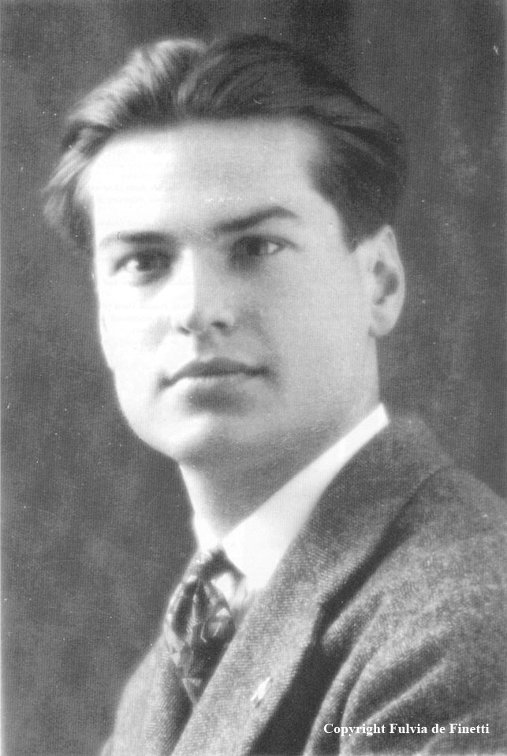
Definition of probability
Bruno de Finetti (1906 – 1985)
Subjective
“Probability does not exist”

Slide 3
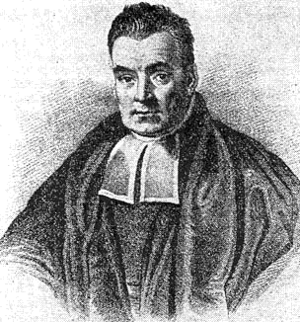
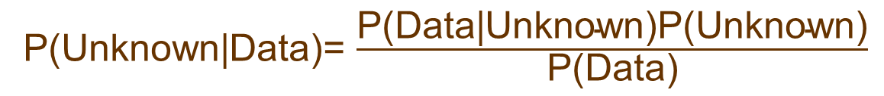
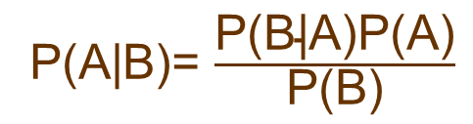
Bayes Theorem & Posterior distribution
P(A|B)= $\frac{\text{P}\text{(}\text{B}\text{|}\text{A}\text{)}\text{P}\text{(}\text{A}\text{)}}{\text{P}\text{(}\text{B}\text{)}}$
P(Unknown|Data)= $\frac{\text{P}\text{(}\text{Data}\text{|}\text{Unknown}\text{)}\text{P}\text{(}\text{Unknown}\text{)}}{\text{P}\text{(}\text{Data}\text{)}}$
P(Unknown|Data) $∝$ $\text{P}\text{(}\text{Data}\text{|}\text{Unknown}\text{)} \text{P}\text{(}\text{Unknown}\text{)}$
posterior
likelihood
(model for data)
prior

Slide 4
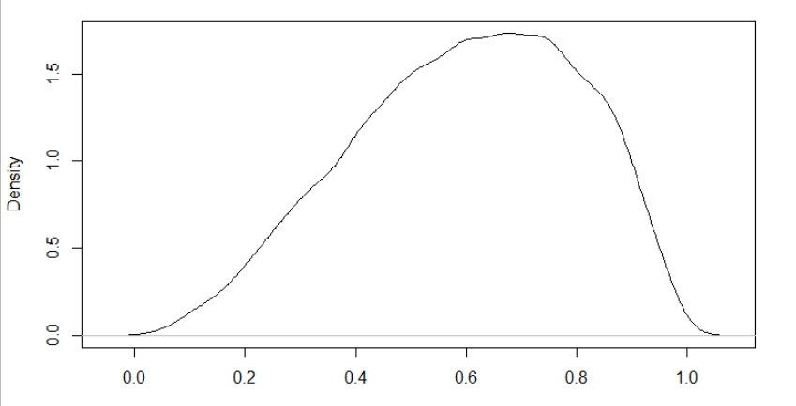
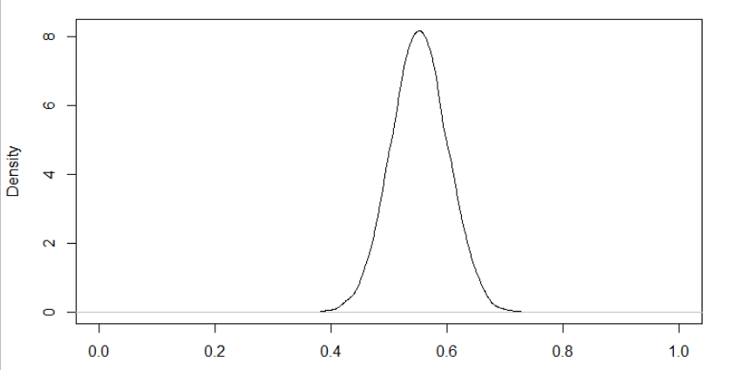
Binomial distribution
Prior for θ:
θ ~ Beta(a=3, b=2)
E(θ) = 0.6, SD(θ) = 0.2
n = 100, x = 55 (e.g. boys born)
Posterior:
θ|x ~ Beta(a+x , b+n-x) ➔ Beta(3+55 , 2+100-55)
E(θ|x) = 0.552, SD(θ|x) = 0.049

Slide 5
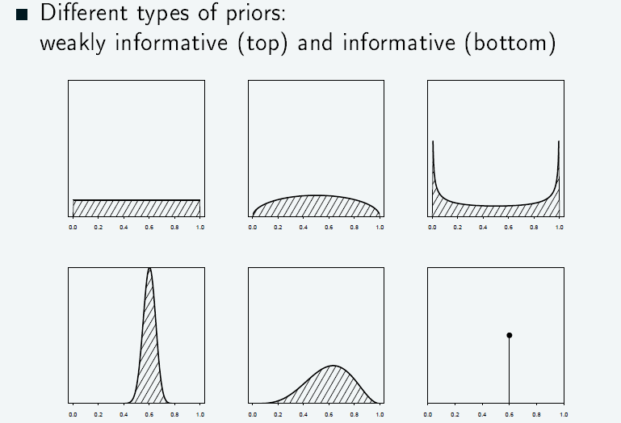
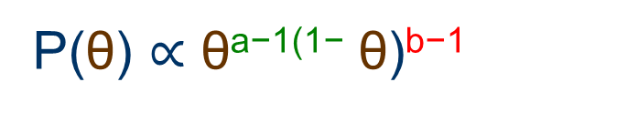
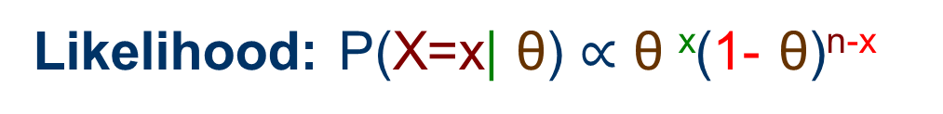
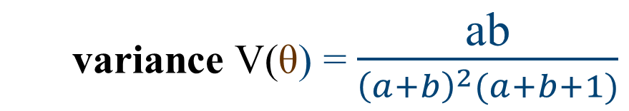
Binomial distribution
X ~ Binomial(n,θ)
Likelihood: P(X=x| θ) $∝$ θ ^{x}(1- θ)^{n-x}
Prior: θ ~ Beta(a,b)
P(θ) $∝\text{θ}\text{a}\text{−1(1−} \text{θ}\text{)}\text{b}\text{−1}$
expectation E(θ) = a/(a+b)
variance V(θ) = $\frac{\text{ab}}{{\left(a+b\right)}^{2}(a+b+1)}$

Slide 6
Frequentist vs Bayesian
Frequentist:
“Evaluates the accuracy of an estimate of an unknown value in terms of how different this estimate could be”
unknown value (parameter, prediction) is fixed
Bayesian:
“Updates beliefs about the true unknown value (parameter of prediction)”
Beliefs are expressed using probabilities
→ unknown value has a probability distribution

